Slide 1
Wrapper Classes and ways of taking input from user

Slide 2
Java Wrapper Classes
In Java, wrapper classes are used to represent the primitive data types as objects.
These classes are part of the java.lang package and provide a way to wrap primitive values into an object, making it possible to store them in data structures that require objects (e.g., ArrayList).
Why Use Wrapper Classes?
Collections Framework Compatibility: Collections like ArrayList can only store objects, not primitives.
Utility Methods: Wrapper classes provide utility methods for parsing, converting, and comparing values.
Nullability: Wrapper classes allow null values, which primitives do not support.

Slide 3
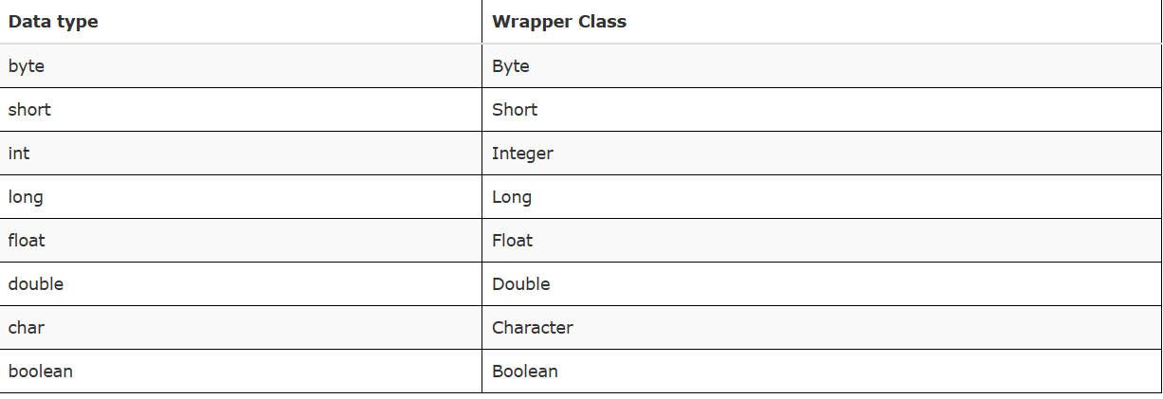
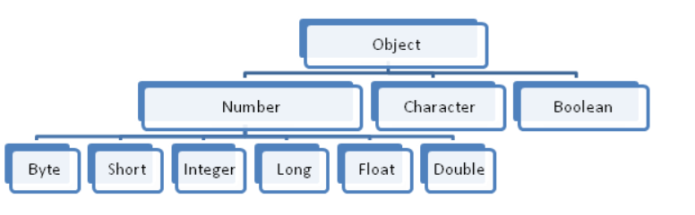
Wrapper class hierarchy -

Slide 4
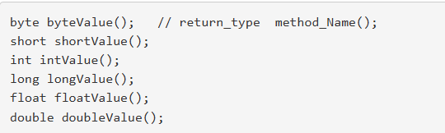

As shown in above figure all numeric type inherit Number class . This class define methods to return the value stored in wrapper class of these data types.
for example -
We can store the value within wrapper class either directly (as in above example) or by using constructor (constructor will be covered later). All numeric primitive type wrapper classes have two types of constructors -

Slide 5
1. One take value of the same type.
Integer(int value)
Double(double value)
For Example –
Integer a= new Integer(66);
Double b= new Double(10.13);
2. Another take string in valid format.
Integer("String in valid format")
Double("String in valid format")
For Example –
Integer a= new Integer("66");
Double b= new Double("10.13");
If string is not in valid format then a NumberFormatException is thrown.

Slide 6
Example -
public class Demo
{
public static void main(String args[])
{
Float f1 = new Float(10.12f); // boxing
float f2 = f1.floatValue(); // unboxing
System.out.println(f1 + " " + f2);
}
}

Slide 7
This program wraps the float value 10.12 within a Float wrapper class and this process of wrapping (storing) primitive values in corresponding wrapper class is known as Boxing.
And in the next line value is extracted from Float wrapper class using floatValue() method of Number class and stored in primitive type variable f. This process of extracting value from wrapper class is known as Unboxing.

Slide 8
Character and Boolean wrapper classes -
Character and Boolean are the wrapper class for char and boolean primitives type respectively. These classes directly belong to Object class.
Character class - Character class has the following constructor -Character(char ch)
Here ch represents a char value that you want to wrap in Character wrapper class.
You can extract value back using charValue() method.
For example –
char ch1 = 'a';
Character ch2 = new Character(ch1);
char ch3 = ch2.charValue();

Slide 9
Boolean class –
Boolean class has the following constructors –
1- Boolean(boolean b1)
2- Boolean(String str)
Here b1 represents boolean value and String represents a string in valid format(i.e. “true" or “false") that you want to wrap in Boolean wrapper class.
You can extract value back using booleanValue() method.
For example –
boolean b1 = true;
String s1 = "true";
Boolean b2 = new Boolean(b1); // boxing
Boolean b3 = new Boolean(s1); // boxing
boolean b4 = b2.booleanValue(); //unboxing
boolean b5 = b3.booleanValue(); //unboxing

Slide 10
Autoboxing and AutoUnboxing –
Since jdk1.5 java supports the concept of Autoboxing and AutoUnboxing.
The process of automatic conversion of primitive data type values into objects of corresponding wrapper class is known as Autoboxing.
For example –
int a=10;
Integer b = a;
And the process of extracting back the value of primitive data type from object type of corresponding wrapper class is known as AutoUnboxing.
For example –
Character ch1 = 'a';
char ch2 = ch1;
So now there is no need to do it manually, Java automatically does it for you.

Slide 11
Example -
public class Demo
{
public static void main(String args[])
{
Float f1 = 10.12f; // Autoboxing
float f2 = f1; // AutoUnboxing
System.out.println(f1 + " " + f2);
}
}

Slide 12
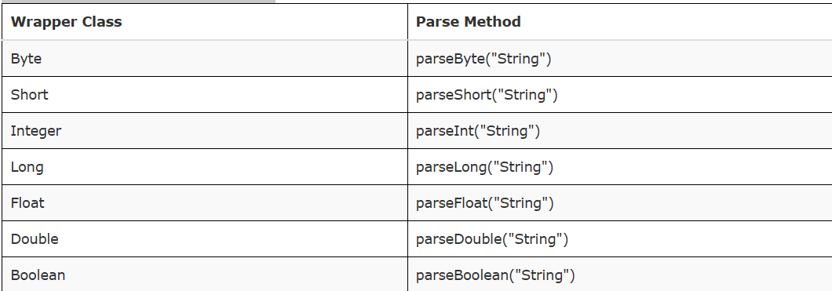
Converting(Parsing) String into primitive type –
Each of the wrapper classes except Character have a parse() method that is used to convert a valid value of primitive type in string format into corresponding primitive data type.
It is a static method i.e. can be accessed directly by class name without creating any object of the class(static keyword will be covered later in detail). It is defined as follows -
Notes:
Note - Here string should be in a valid format that represent primitive type value. Each of the method return corresponding primitive type value.

Slide 13
Example -
public class Demo
{
public static void main(String args[])
{
String s1 = "12";
String s2 = "12.12f";
String s3 = “true";
int a = Integer.parseInt(s1);
float b = Float.parseFloat(s2);
boolean c = Boolean.parseBoolean(s3);
System.out.println("a = "+a+" b = "+b+" c = "+c);
}
}

Slide 14
Receiving input from user -
1- Using readLine() method of java.io.Console class -
It is one of the simplest method to take input from user keyboard added in jdk1.6 using Console class.
Console class has a method named readLine(), which read a complete line and return the value in String format.
As we already know, to access methods of a class we need to create object of the class. We can create object of Console class as follows –
Console c = System.console();
After creating object we can access its readLine() method by using . (period) sign as follows -
String s = c.readLine("Enter input");
Or we can combine these lines into one as follows –
String s = System.console().readLine("Enter input");
This class is not available in IDEs like Eclipse but works well in terminal-based environments.
Notes:
Note - We have passed a String parameter in readLine() function and it is optional, if you pass any message then the message will be displayed first and then it takes input value, if you do not pass any message then it directly takes user input.

Slide 15
Example -
Program for the addition of two numbers input by the user -
public class Demo1
{
public static void main(String args[])
{
int a,b,c;
String s1 = System.console().readLine("Enter first number");
a = Integer.parseInt(s1);
/* We can combine above two line into one as follows -
a = Integer.parseInt(System.console().readLine("Eneter first number"));
*/
b = Integer.parseInt(System.console().readLine("Eneter second number"));
c = a+b;
System.out.println("Sum = "+c);
}
}

Slide 16
2.Using java.util.Scanner class -
The Scanner class in Java is part of the java.util package and is widely used to read user input from various input sources, including the keyboard, files, and strings. It simplifies the process of receiving input and parsing it into various data types such as int, double, String, etc.
How to Use the Scanner Class
1. Import the Scanner Class
To use the Scanner class, import it:
import java.util.Scanner;
2. Create a Scanner Object
Create a Scanner object, typically for System.in to read from the keyboard:
Scanner scanner = new Scanner(System.in);

Slide 17
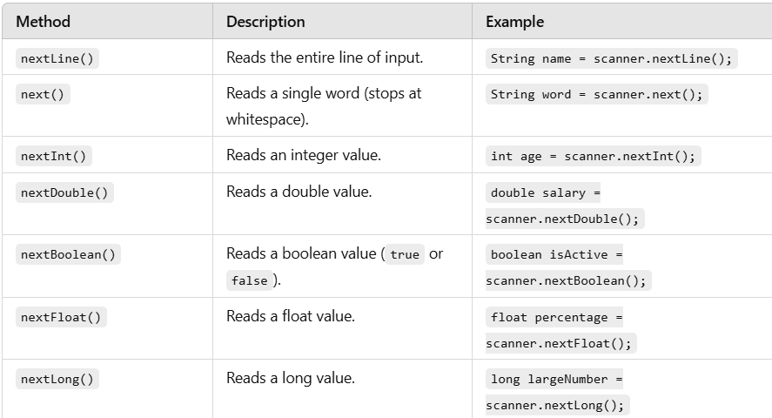
3. Use Methods to Read Input
The Scanner class provides various methods for reading input based on data type.

Slide 18
Example –
import java.util.Scanner;
public class ScannerExample {
public static void main(String[] args) {
Scanner scanner = new Scanner(System.in);
// Reading a string
System.out.print("Enter your name: ");
String name = scanner.nextLine();
// Reading an integer
System.out.print("Enter your age: ");
int age = scanner.nextInt();
// Reading a double
System.out.print("Enter your salary: ");
double salary = scanner.nextDouble();
System.out.println("Hello " + name + "! You are " + age + " years old and earn $" + salary + ".");
scanner.close();
}
}
Notes:
Advantages of Using Scanner
Simple and intuitive for beginners.
Supports input parsing directly into desired types.
Versatile in handling multiple input sources.
Disadvantages
Slower compared to BufferedReader for large input.
Requires careful handling when mixing input methods.

Slide 19
Avoid Mixing nextLine() with Other Methods
When using the Scanner class, mixing nextLine() with other input methods (like nextInt(), next(), etc.) can cause unexpected behavior.
Methods like nextInt(), nextDouble(), next() read only the specific token or value from the input, leaving the newline character (\n) in the input buffer.
When nextLine() is called afterward, it immediately consumes the leftover newline character instead of waiting for new input.

Slide 20
Example of the Problem –
import java.util.Scanner;
public class MixingInputExample {
public static void main(String[] args) {
Scanner scanner = new Scanner(System.in);
System.out.print("Enter your age: ");
int age = scanner.nextInt(); // Reads the integer but leaves the newline character
System.out.print("Enter your name: ");
String name = scanner.nextLine(); // Reads the leftover newline, causing an empty string
System.out.println("Age: " + age);
System.out.println("Name: " + name); // Name will be empty
}
}
Notes:
Enter your age: 25
Enter your name:
Age: 25
Name:

Slide 21
To fix this issue, add an extra nextLine() call after methods like nextInt() or next() to consume the leftover newline character before reading the actual input.
import java.util.Scanner;
public class MixingInputFixed {
public static void main(String[] args) {
Scanner scanner = new Scanner(System.in);
System.out.print("Enter your age: ");
int age = scanner.nextInt(); // Reads the integer
scanner.nextLine(); // Consume the leftover newline
System.out.print("Enter your name: ");
String name = scanner.nextLine(); // Now reads the actual input
System.out.println("Age: " + age);
System.out.println("Name: " + name);
scanner.close();
}
}

Slide 22
Best Practices -
Plan Input Reading Carefully: If you need to mix nextLine() with other methods, ensure you handle the newline character correctly.
Prefer nextLine() for All Input: You can use nextLine() for all input and manually parse the string into the required type:
System.out.print("Enter your age: ");
int age = Integer.parseInt(scanner.nextLine()); // Parse input manually

Slide 23
3.Using java.io.BufferedReader class -
Using the java.io.BufferedReader class to take user input in Java is a traditional method that reads input as text. It's efficient for handling large inputs and is often paired with InputStreamReader to read data from the keyboard (standard input).
Here’s a step-by-step explanation of the process:
Import Required Classes
To use BufferedReader, you need to import classes from the java.io package:
import java.io.BufferedReader;
import java.io.InputStreamReader;
import java.io.IOException;

Slide 24
create object of InputStreamReader class –
InputStreamReader isr = new InputStreamReader(System.in);
InputStreamReader: Converts byte-based streams (like System.in) into character-based streams.
Next connect this InputStreamReader stream to BufferdReader object –
BufferedReader br = new BufferedReader(isr);
BufferedReader: Reads text from a character-based input stream, buffering characters for efficient reading.
Finally call readLine() method on BufferedReader object –
String str = br.readLine(); // throws IOException
Note - This readLine() method is different from the method we learned in Console class. It cannot have string massage within it. And it also throws IOException.

Slide 25
Example -
Program for the addition of two numbers input by the user -
import java.io.InputStreamReader;
import java.io.BufferedReader;
import java.io.IOException;
public class Demo3
{
public static void main(String args[])throws IOException
{
int a,b,c;
InputStreamReader isr = new InputStreamReader(System.in);
BufferedReader br = new BufferedReader(isr);
System.out.println("Enter first number");
String str1 = br.readLine();
a= Integer.parseInt(str1);
System.out.println("Enter second number");
String str2 = br.readLine();
b = Integer.parseInt(str2);
c = a+b;
System.out.println("Sum = "+c);
}
}
Notes:
Key Points
Efficiency: BufferedReader is efficient for reading large amounts of text because it buffers input.
Always Reads Strings: You need to manually parse the input if a different data type is required.
Exception Handling: Handle IOException and NumberFormatException for robust programs.

